Slide 1

Flower Classification using ResNet50V2
Deep Learning
Presented by: Khelif Abdellah and Amara Ouail Said

Slide 2
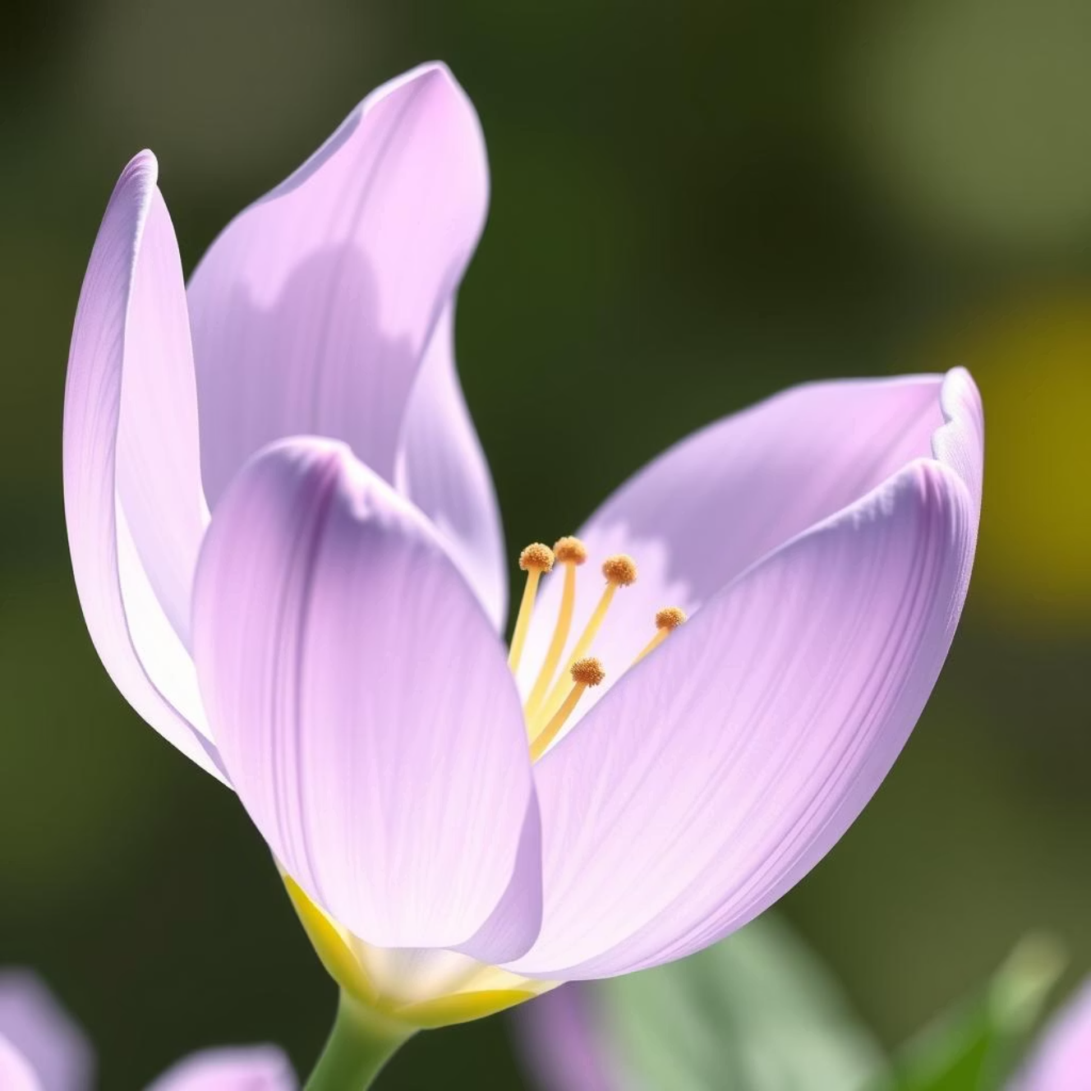


Introduction to Image Classification
This project explores the fascinating world of deep learning for image classification, specifically focusing on identifying various flower species. We leverage the power of TensorFlow and a pre-trained ResNet50V2 model to achieve high accuracy.
Flower classification is not just an academic exercise; it has practical applications in botany, agriculture, environmental monitoring, and even in creating intelligent visual search systems. Accurate identification contributes to biodiversity conservation and plant disease detection.
Dataset Used:
Oxford Flowers 102 - A comprehensive collection of flower images.

Slide 3


Dataset Overview: Oxford Flowers 102
102 Categories
8,189 Images
Integer Labels
Diverse range of flower species.
Sufficient data for robust training.
Each category assigned a unique integer.
80%
10%
10%
Training Data
Validation Data
Test Data
For model learning.
For hyperparameter tuning and preventing overfitting.
For final model evaluation.

Slide 4



Data Preprocessing & Augmentation
To ensure optimal model performance and generalization, raw image data undergoes critical preprocessing and augmentation steps.
Image Resizing: All images are uniformly resized to 224x224 pixels, matching the input requirements of ResNet50V2.
Normalization: Pixel values are normalized using ResNet's specific preprocessing function, scaling them to the range [-1, 1].
Data Augmentation: Techniques like RandomFlip (horizontal and vertical), RandomRotation (up to 20 degrees), and RandomZoom (up to 20%) are applied to create synthetic variations of the training data.
The primary purpose of augmentation is to reduce overfitting and improve the model's ability to generalize to unseen images by introducing variability.

Slide 5






Model Architecture: ResNet50V2 with Transfer Learning
We utilized a pre-trained ResNet50V2 model as the foundation for our classifier, leveraging the power of transfer learning.
Base Model
Freeze Base
Custom Top Layers
ResNet50V2: Pretrained on the ImageNet dataset, providing robust feature extraction capabilities.
The weights of the base ResNet50V2 model are frozen to preserve its learned features.
Additional layers are added and trained specifically for flower classification:
GlobalAveragePooling2D: Reduces spatial dimensions.
Dropout (0.2): Regularization to prevent overfitting.
Dense (102 units, softmax activation): Output layer for 102 flower classes.
Global AvgPool
Dense (Softmax)
ResNet50V2
Dropout

Slide 6






Key Deep Learning Concepts
Softmax Activation
Convolutional Neural Network (CNN)
Converts raw model outputs (logits) into a probability distribution, indicating the likelihood of an image belonging to each flower class.
A class of deep neural networks, highly effective for image processing tasks by automatically learning hierarchical features.
Transfer Learning
Data Augmentation
Leveraging knowledge from a model pre-trained on a large dataset (e.g., ImageNet) to a new, related task. Significantly reduces training time and data requirements.
Generating diverse training examples by applying random transformations (rotation, flip, zoom) to existing images. Prevents overfitting and improves generalization.
TensorFlow
Keras
An open-source machine learning platform, offering a comprehensive ecosystem of tools, libraries, and community resources for building and deploying ML-powered applications.
A high-level neural networks API, written in Python and capable of running on top of TensorFlow, CNTK, or Theano. Designed for fast experimentation.

Slide 7
Training Process
01
02
Optimizer: Adam
Loss Function: SparseCategoricalCrossentropy
An adaptive learning rate optimization algorithm for stochastic gradient descent, known for its efficiency.
Suitable for multi-class classification problems with integer labels, calculating the difference between predicted probabilities and true labels.
03
04
Metrics: Accuracy
EarlyStopping Callback
The primary metric used to evaluate model performance, indicating the proportion of correctly classified images.
Monitors validation loss and stops training if it doesn't improve for a specified number of epochs, preventing overfitting.
Initial Training: Only the newly added custom layers (top layers) are trained for faster convergence.
Fine-tuning: After initial training, the last 30 layers of the ResNet50V2 base model are unfrozen and trained with a very low learning rate to subtly adjust features and improve performance further.

Slide 8
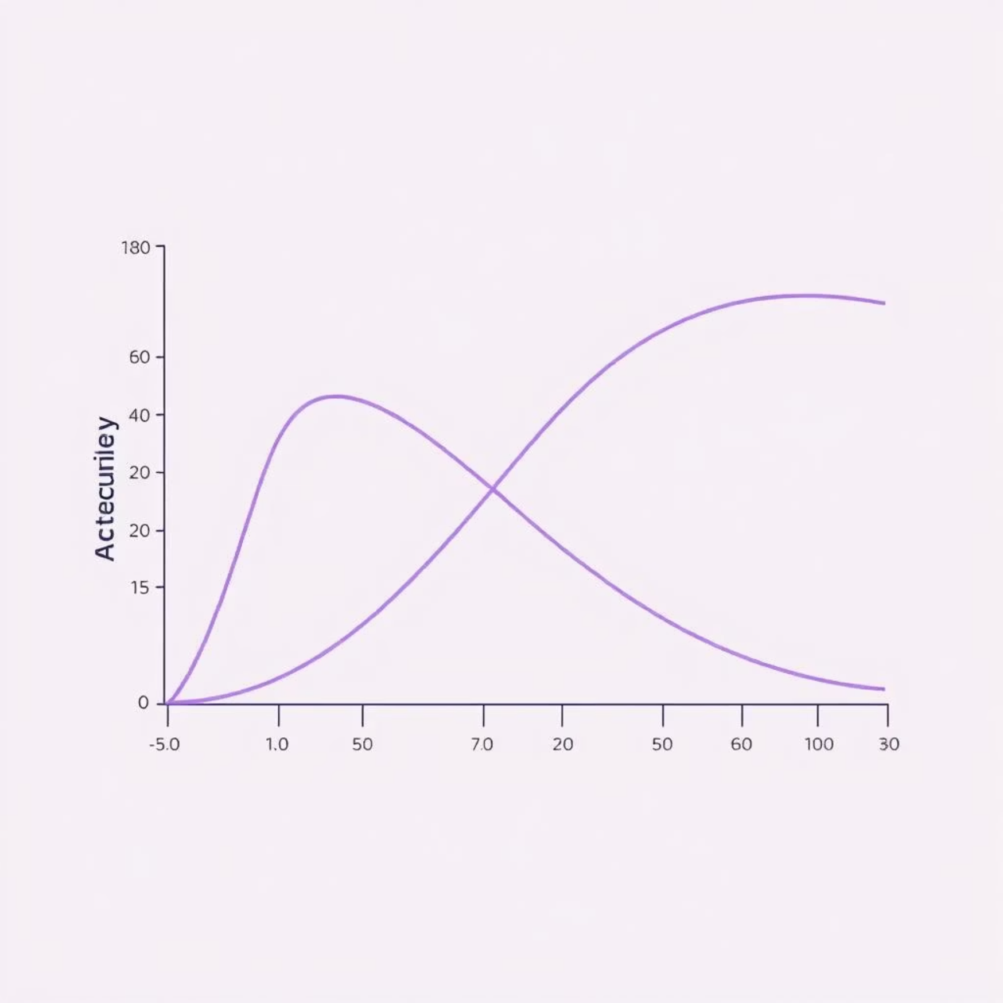
Results & Performance Analysis
The training process yielded encouraging results, demonstrating the effectiveness of the chosen architecture and training strategy.
92.5%
0.21
Validation Accuracy
Validation Loss
Achieved on unseen validation data.
Indicating good model generalization.
Observations
Data Augmentation: Significantly contributed to the model's robustness and ability to generalize, mitigating overfitting.
Fine-tuning: Unfreezing and training the deeper layers of ResNet50V2 led to a noticeable boost in accuracy, capturing more nuanced features.
The model showed consistent performance between training and validation sets, indicating a well-balanced training process.

Slide 9




Model Saving & Deployment
After successful training, the final model is saved for future use and potential deployment.
model.save("flower_model.h5")
Inference
The saved model can be loaded and used to classify new, unseen flower images with high confidence.
App Deployment
Potential for integration into a mobile application or web service, allowing users to identify flowers from photos.
API Integration
Exposing the model as an API endpoint for other applications or researchers to utilize its classification capabilities.

Slide 10
Conclusion & Future Directions
This project successfully developed a robust deep learning model for flower classification using ResNet50V2 and TensorFlow, achieving strong performance metrics.
Key Learnings
Potential Improvements
Transfer learning with pre-trained models is highly effective for image classification tasks with limited datasets.
Experiment with other ResNet variants or different architectures (e.g., EfficientNet).
Strategic data augmentation is crucial for model generalization and preventing overfitting.
Explore advanced augmentation techniques like CutMix or Mixup.
Fine-tuning deeper layers can unlock significant performance gains.
Implement interpretability techniques (e.g., Grad-CAM) to understand model decisions.
Investigate real-time deployment strategies for edge devices.
References
TensorFlow Documentation | Oxford Flowers 102 Dataset | Deep Learning Tutorials

